Slide 1
May 6 – 7, 2021
Sié Chéou-Kang Center for International Security & Diplomacy
Josef Korbel School of International Studies
University of Denver
Sponsored by Carnegie Corporation of New York

Slide 2
Unpacking the Black Box:
The Policy Process and Opaque Institutions
Judd Devermont and Leanne Erdberg Steadman

Slide 3
Session Agenda
Lecture (25 mins)
Exercise (50 mins)
Part 1: Briefs between Policymakers and Academics
Breakout Brief 1
Defense/Military policymakers & Military Analysis Researchers
Diplomacy/Development policymakers & Politics, Governance, State-building, Fragility Researchers
Breakout Brief 2
Defense/Military policymakers & Politics, Governance, State-building, Fragility Researchers
Diplomacy/Development policymakers & Military Analysis Researchers
Part 2: “Policymakers” prepare and refine arguments, decide on 2 main speakers to brief “senior leaders”
Part 3: Policymakers brief senior leaders (Judd and Leanne)
All others watch this brief
Discussion (15 mins)
Notes:
Quick introductions and an explanation of the format, to include introducing the rules and instructions for the exercise.

Slide 4
Lecture Objectives
Guide Inside the Black Box
The Process
The Players
The System
Understand How Information is Used Behind Closed Doors
Discuss Ethical, Responsible, and Moral Hazards Implicit in Interactions
Outline Best Practices and Potential Allies
Notes:
Talking notes:
As you probably gathered already, the readings for our session are focused on the exercise at hand, not on the overall topic of policy black box. So we wanted to spend the lecture talking a bit from our professional experiences as an insider’s view of policymaking for the U.S. national security process.
Not all policy processes are the same – so we will stick to what we know – the NSC process. We’ll talk about the process, the players, and what we are calling the overall system in the high levels of federal US policymaking. We will also talk through some of the ways that information is used behind closed doors.
We will spend the lecture talking about some potential challenges that scholars/researchers may confront when engaging with policymakers. And we will tackle some of the gray areas of morals, ethics, and responsibility implicit in interactions when you have information asymmetry, unknown players, and unknown decision points.
The goal of the lecture and the exercise is for us to help unpack a bit of what might be happening on the policymaking side, so that future policy engagements might be a bit more informed for academics who engage with policy processes.

Slide 5
Inside the Black Box
Research can be treated as auxiliary to policy positions
How similar or different pieces of research feeds different agency objectives
Same research can influence a tabla rasa, a very well-defined worldview, a live policy deliberations
What is lost in translation
How research might contribute (or not contribute) to policies
Impact in ways that academics would not necessarily predict
Process
Players
Sociol-ogical Situation Room
View of Academia
Notes:
Following this slide, we will unpack the process, players, and a bit of how policymakers might view each other and view academia. But before we get there, this slide hopes to delineate a few of the unknowns of policy engagement. Namely, things that you, briefing policy makers or engaging with policy relevant audiences, might never know, or only know partially. By outlining these, and asking these questions before and during policy engagement, you can help better situate yourself and your part in a process.
Is your research being used to interrogate assumptions or just reify already held positions?
Is your research being seen very differently by different agency players – especially if it is from a player within a part of a bureaucracy that might not have sway over their colleagues?
Are you entering a sociological situation room – where are the positions of power? Are they based on agency position? Stay conscious of who speaks first and that can sway the room; where sometimes saying nothing is a powerful move, and how fully formed decisions might be before anyone ever meets you.
Was your research at all part of the policy deliberation, or maybe it was part of one portion but not another. This might be because at a particular stage, policymakers already have marching orders, or are trying to glean additional insights to bolter the case, or you may be part of a check box exercise and never know it.
Who you engage with is not treated equal – are you talking to staffers/decision makers, and also not all policymakers are equal and not all government policymakers are not decisionmakers.
What gets lost in translation – specifically on findings leading to recommendations, the limitations of caveats, and whether minor points get emphasized ahead of major ones
How comfortable are you knowing that policy pieces you are informing are classified, or even the people you meet who you might not know
All of these pieces can be part of a system where academics don’t always know how their research will impact policies

Slide 6
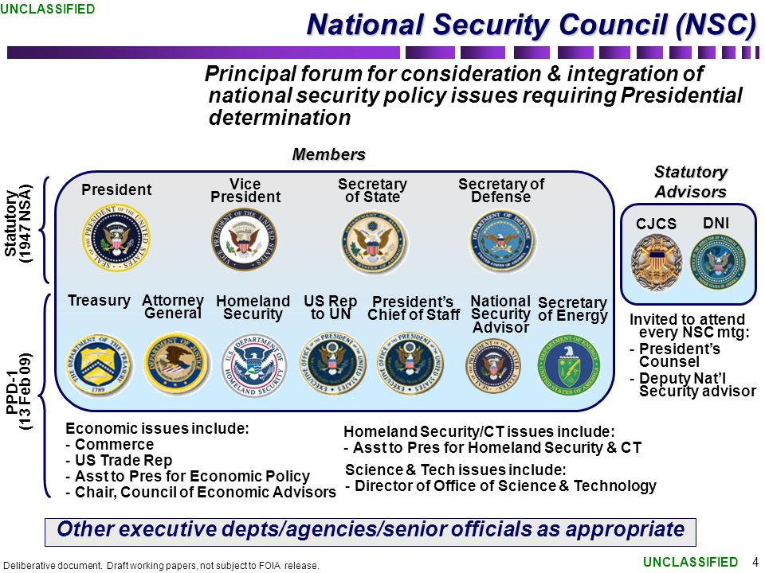
This is the Process
Notes:
Understanding the National Security process is essential for academics. In 1947, President Truman created the National Security Council to strengthen interagency coordination and address policy disputes. The President can decide which departments and agencies are part of the NSC. For example, Democrats usually include the US Ambassador to the UN whereas Republicans often do not. (President Trump did for Nikki Haley, but not her successor.)
An academic may have access to only one of these departments or agencies, and thus they are only informing one actor among many.

Slide 7
This is the Process
Notes:
The President chairs National Security Council, and it serves as the final forum for adjudicating decisions. At the lowest level, NSC directors chair the sub-Interagency Policy Committee (sub-IPC) under Democratic Administrations or sub-Policy Coordinating Committee (sub-PCC) under Republic administrations.
An academic may be engaging a member of one of these policy committees, but more likely they are talking a desk officer or action officer who is writing the talking points and drafting proposals.

Slide 8
This is the Process
Notes:
Most issues are first considered at the sub-IPC/sub-PCC and move up the chain until there is a decision. Some issues can be resolved at the sub-IPC/sub-PCC, while others require more senior attention. If there are disagreements between agencies and departments, it will go to the next level for decision. This process can repeat itself if the President or a senior official is displeased with the choices presents. (see Obama’s three-month Afghanistan review in 2009.)
There are circumstances where deliberations starts at higher levels, and then are sent down to the IPC/PCC or sub-IPC/sub-PCC for further consideration or refinement. It depends on the issue and the preference of the Administration. For example, Trump’s National Security Adviser McMaster preferred to have a high-level discussion before tasking the issue to the IPC/PCC or sub-IPC/sub-PPC.

Slide 9
A Cultural Anthropology Study on Policymakers
Barriers
Language
Culture
Theory
Methods
Not Showing Homework
Stakes, tradeoffs, consequences
Not unaware of the downsides
Not stupid
Value academics
Politics v. Policy
Want to do good
Notes:
So, on the left of the slide, we have barriers and, on the right, we have clearing up of assumptions.
Starting with the assumptions – some are really exaggerations, but I think still worth mentioning as a rhetorical tool, to remind ourselves to look out for them when they appear in more nuanced ways in real life. If you were in the group that read the assigned article by Jon Finer and Rob Malley, you would have picked up on some of these themes in their self-reflections.
- Most policymakers want to do good; they value academics (many of them have studied with or are former academics), they are generally quite smart on their subject matter areas, and when it comes to specific policies, they are not unaware of downsides. Instead, they are often more focused on areas like stakes, tradeoffs, and consequences – or they are caught between policy choices and political reverberations.
- Those aspects are rarely articled in public fora but are front and center behind closed doors.
And when it comes to barriers, there are some cultural differences that are worth spelling out, that can unfortunately mean that policymakers do not truly benefit from the wisdom and findings of academia. These are not always true, but I think enough of the time to worth detailing
- Methods – policymakers rarely care about methods, and even if they care, their boss does not. put it in the annex, leave it for Q&A
- Theory – policymakers rarely articulate their own theories – they are more concerned with goals, objectives, and theories of change
- Not showing homework – this is like methods but also a bit more ubiquitous – it is sometimes difficult for a person, all of us included, to not want to demonstrate all the effort than went into a set of findings – to show homework. This can be important but can also be a barrier
- Language – this is simple, but simpler and clear language is always preferred to more technical jargon. This is not a symbiotic relationship – policy makers will use acronyms you might not know and never stop to define them, but many also will not ask you to define things they do not understand, and that is often a lost opportunity
- Culture – lastly, there are cultural barriers that are too numerous to detail, but they range from briefing style, to interruptions, how the story of one person can be more persuasive than rigorous empirical statistics, to ghosting - and they come into play in many ways.

Slide 10
What the CIA Says About Policy Makers
1. All policy makers, regardless of their training, expertise, or track record believe themselves to be excellent political analysts. […] Policy makers know they are politically savvy – that is why they are in the position they are in – and they have tremendous confidence in their political judgment.
2. Policy makers are overwhelmingly “people” people. They think in terms of people, not history or trends. They see politics as people making deals, people maneuvering for advantage, people acting.
3. Policy makers have met the people intelligence analysts write about. In many cases, they have known them for years, both in and out of power. As a result, senior officials believe that they know these people in ways that the analyst does not and cannot.
4. Policy makers believe they read all people equally well. One reason they are where they are is because they have excellent people skills.
Notes:
In 2003, CIA senior officer Martin Peterson published ”The Challenge for the Political Analyst” in Studies for Intelligence. It is as instructive for analysts as it is for academics when engaging with policymakers.

Slide 11
Where and How Academics Engage
Start of policy process (sub-IPC)
Junior staff
Have priorities, but no fixed approach
Best opportunity to influence
Middle of Policy Process (IPC)
Assistant Secretary-Equivalent
Approach Developed, but Open to Course Correction
Shrinking window for influence
Deadlocked Process (IPC or DC)
Sub-Cabinet Level
Approach Set, looking for evidentiary support
Limited opportunity to influence
End of Policy Process (PC or NSC)
Cabinet Level
Approach Set, Box-checking exercise
No opportunity to influence
Notes:
Where and how academics engage within the interagency process is crucial.
There is more opportunity to influence at the sub-IPC/sub-PCC stage because there is an openness to new ideas and willingness to refine policy proposals based on academic insights. As the issue moves up the chain, the academic may struggle to inform policy. There is still a window for influence at the IPC, but mainly course corrections and adjustments.
If there a deadlocked IPC or a Deputies Committee, most agencies and departments have established positions on the question at hand. They are likely to turn to academics not for new ideas, but for ammunition to strengthen their proposals in the face of opposition.
At the PC or NSC-level, most officials are engaging academics as a box-checking exercise or to identify potential public validators. It is difficult to shift the conversation from the outside at this level.

Slide 12
Processing the Same Information
Explanation
Recommendation
More Research
Caveats
Recommendation
Caveats
Explanation
More Research
Notes:
I struggled with graphics for this slide because it is not that straightforward to explain.
I love a great academic paper and briefing because I think they do a good job of explaining things – explaining how variables were selected, how complexity can be explicated, and what are limitations and needs for more research. This is a very different style I have found from policy related papers, which often center recommendations, and while they might provide some explanations and caveats, the focal point remains on the doing, not the thinking behind it.
This difference is one of content but also of presentation. Policy processes often are looking for recommendations (backed by explanations) but few policymakers’ jobs are to explain phenomena, their job is to figure out ways to change complex systems. So, while the same information may be at play, an academic article and a policy paper might have very different volume of information devoted to differing facets. This is especially important if you are working with policymakers who are short on time.

Slide 13
Intermediaries
(Journalists, Think Tanks, Consultants)
Aggregators
Access
Insider Knowledge
Influence
Objectivity
Notes:
This slide is a short reminder that there are often a variety of intermediaries between academics and policymakers – and not just because Judd and I both belong to this category. But people in think tanks, journalists, consultants and even lawyers can all be helpful bridges between academic and policy circles.
In think tanks, there may be room for an academic idea to further ideate and incubate, they may provide platform for academics – present and share – bend toward better decisions. And many think tanks are populated by former Policymakers – they can help strengthen arguments that are your equities and give helpful tips.
Sometimes this involves losing some control as to how findings are aggregated with many other aspects. Sometimes this involves partisan slants, or at times, intermediaries may be funded to focus on very specific aspects, not exactly aligned with the study. So, while it is wise to partner, it is also wise to calculate intermediaries with awareness.

Slide 14
THE EXERCISE

Slide 15
THE EXERCISE
1
Academics Brief Policy makers
Breakout Brief A: (1) Defense policymakers & Military Analysis Researchers and (2) Diplomacy/Development policymakers & Pol, Gov, State-building, Fragility Researchers
2
Policy makers refine arguments
Policymakers group 1 refines presentation
3
Policy makers brief leaders
All in same room
Policymakers group 2 refines presentation
Researchers meet to debrief
Policymakers group 1 and group 2 present
Breakout Brief B: (1) Defense policymakers & Pol, Gov, State-building, Fragility Researchers and (2) Diplomacy/Development policymakers & Military Analysis Researchers
Notes:
Note that policymakers should feel free to interrupt and ask questions
Note that policymakers are coming into this conversation with a point of view, and looking to gather supporting evidence for that position
Researchers are not aware of the policy process underway – they were invited to present on their latest report that was published

Slide 16
Wrap up Discussion:
Best Practices
Ask how much time you have
Present Your ideas In Listicle Form (3)
Limit caveats to 1-2
Use rhetorical devices like – “this is a question I often get”
Be prepared to adjust based on audience expertise
Google your policymaker (if possible)
Use your findings as evidence to enrich your overall “idea”

Slide 17
Wrap up Discussion:
Questions to Consider
How did your information come across when policymakers had digested it?
What would you have done differently?
What would you have liked to have seen?
Considering how fraught direct policy engagement is, is it worth it?
Knowing you are in the black box, what asks will you make of policymakers?
Moral hazards?
Worth your time, their time?
Ethical questions?

