Slide 1
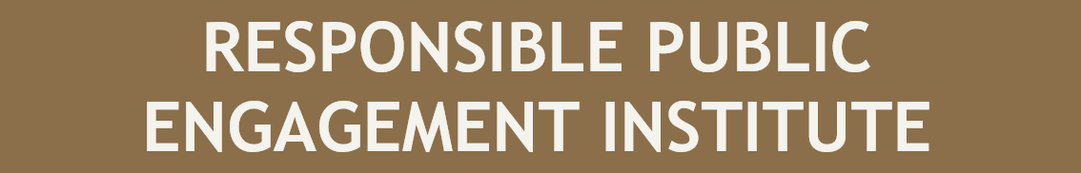
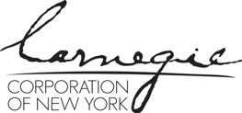


May 6 – 7, 2021
Sié Chéou-Kang Center for International Security & Diplomacy
Josef Korbel School of International Studies
University of Denver
Sponsored by Carnegie Corporation of New York

Slide 2
CHERRY PICKING AND GATEKEEPING
Cullen Hendrix
Notes:
I’ll be talking about asymmetric knowledge and how it affects the cherry picking and gatekeeping behavior. We didn’t talk a lot in grad school about bridging the gap, but we did talk a lot about information asymmetries: what happens when parties in an interaction have private information.

Slide 3
Scholar – Practitioner Interface and Information Asymmetries
Typically, practitioners know more about how they intend to use outcomes of interactions with scholars
  Agendas, mental models for how the world works, policy outcomes or strategies
Typically, scholars know more (or at least differently) about the subject matter or tools of analysis
  What countries are more at risk for environmental shock/change-induced violence (me)
  How to analyze data and draw conclusions (Jay’s collaborative work on the effect of airstrikes on insurgent violence in Iraq)
Notes:
Typically, practitioners know more about how they intend to use outcomes of these interactions than the scholars. This is a fancy way of saying practitioners have their own agendas, mental models of how the world works, and desired policy outcomes or strategies. This isn’t to say all policymakers have strong private agendas some are there to learn and assimilate information; but they do tend to have priors. And as Judd and Leanne pointed out, they also occupy different levels in the process, with different levels of seniority, and because of this, they have different levels of commitment to particular strategies and courses of action. At the end of the policy process, they know what they need you to say to break a deadlock.
Typically, scholars know more (or at least differently) about the subject matter or a particular mode of analysis. Again, policymakers are not dumb, and many know the facts on the ground backwards and forwards. But they probably won’t assimilate those facts in the same ways you would. This is usually why academic is in the room in the first place: to either educate or to reinforce an existing perspective on a particular problem or issue. For example, I’m often asked by folks in the IC and security community to comment on which countries are at most risk for environmental shock-induced conflict, a subject I’ve spent a lot of time thinking about. In another example, Jay’s collaborative work on the effect of airstrikes in Afghanistan helped better inform the military on the effects of its operations by subjecting them to a type of analysis they weren’t in a position to do themselves. Our academic credentials serve to bolster these claims to differential knowledge, and those claims often get stronger the more accolades and professional standing we accumulate. I’ll come back to why this is particularly important to keep in mind in a few minutes.

Slide 4
Scholar – Practitioner Interface and Information Asymmetries
These asymmetries create opportunities for cherry-picking and gatekeeping
Cherry-picking (def.): pointing to individual cases or data that seem to confirm a particular position while ignoring a significant portion of related and similar cases or data that may contradict that position
Gatekeeping (def.): limiting access to information
Can occur both unintentionally and intentionally
  Unintentional: ignorance of potentially useful information
  Intentional: deliberate attempts to manipulate outcomes (policy or otherwise)
Notes:
These types of asymmetric knowledge confer power on the holder thereof, and that power can be wielded in ways that may distort the message academics are sending and/or the way the information is interpreted and used on the receiving end. Specifically, this asymmetric information creates opportunities for cherry-picking and gatekeeping. By cherry picking, I mean pointing to individual cases or data that seem to confirm a particular position while ignoring a significant portion of related and similar cases or data that may contradict that position. By gatekeeping, I simply mean limited access to information in some way, shape, or form.
Both cherry picking and gatekeeping can occur unintentionally. We are not omniscient beings; as up on our areas of expertise as we might be, we can’t know everything. Many times, scholars may unintentionally cherry pick simply because they are ignorant of certain facts. Or, we may cherry pick because the evidence is subject to the streetlight effect, with some cases and questions getting more attention than others. For example, the Joint Poverty Action Lab’s repository of affiliated projects indicates more attention has been paid to three Anglophone African countries - Kenya, Ghana, and Uganda – than the rest of the continent combined. Ignorance is a pervasive part of being human. What I’m more concerned with are the ways cherry picking and gatekeeping can be used deliberately to manipulate outcomes, be they practitioner understanding of a subject, policy choices, or professional outcomes for academics.

Slide 5
Demand- and Supply-Side Challenges
Cherry-picking (demand-side)
  Challenge 1: misrepresentation/mischaracterization
  Challenge 2: gatekeeping
Cherry-picking (supply-side)
  Challenge 1: gatekeeping and stealth advocacy
  Challenge 2: strategic selection on practitioner side
Notes:
I’ll focus on four ways these dynamics create challenges for responsible engagement. First, I’ll look at the demand-side, with the demand-side describing the consumers of academic expertise. Then, I’ll look at the supply-side, or the dynamics that originate from the academic’s role in the interaction.
On the demand-side, the thorny issues are deliberate misrepresentation and then gatekeeping, especially in bureaucratic organizations where lower-level bureaucrats control information flow up the line, so to speak.

Slide 6

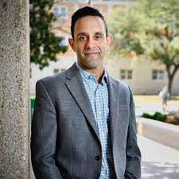
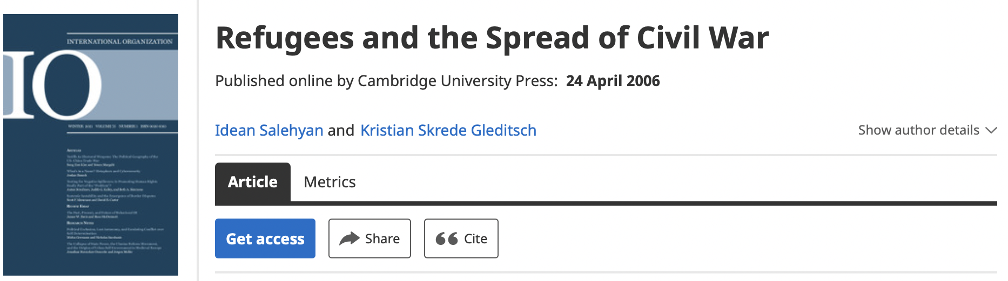
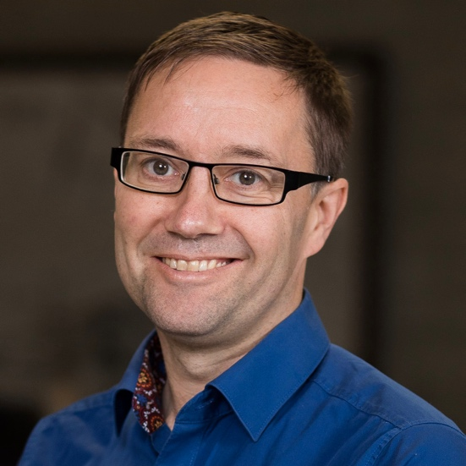
Misrepresentation (Demand-Side)
Notes:
When I say misrepresentation, I simply mean a practice many of us may be familiar with in our academic lives: having something attributed to you that you did not say or twisting the interpretation of your work or insights for obvious political ends. Here’s a particularly egregious example of misrepresentation. In 2006, Idean Salehyan and Kristian Gleditsch published “Refugees and the Spread of Civil War,” a paper that found that the risk of a country experiencing a civil war rose if a neighboring country was fighting a civil war and the country was hosting refugees from that neighboring country. This finding was seized on by the users of Stormfront, a white supremacist website and hub for online white supremacy activism, but also by more mainstream activists arguing for tighter restrictions on hosting refugees in the United States because of the attendant political risk. But the article clearly showed refugee flows increased civil war risk only under very specific circumstances that are not present in the United States. Their work was being deliberately twisted to suit a particular political agenda – and by some very nefarious actors. And as Leanne and Judd pointed out, it may not even be intentional; it may be a process of telephone, where mediators change the message simply because things are lost in translation.

Slide 7



Gatekeeping (Demand-Side)
Notes:
The issue of gatekeeping is somewhat different. Let’s imagine a scenario in which a policymaker (or policymakers) request to be briefed on a subject by an academic expert. Let’s further assume the academic is doing their level-best to present a broadly accurate picture of scholarly consensus on a particular question and provide a sense of the set of policy alternatives available to the policymaker so that they can make an informed decision; this is what Roger Pielke refers to as honest brokerage.
The briefing occurs, and the academic paints a picture of the consensus on a particular issue; that consensus is represented here by Van Gogh’s starry night. Subsequently, however, the policymaker has to send the information “up the chain,” so to speak, further briefing their bosses or senior administrators who make ultimate policy decisions. Moreover, this process occurs when the scholar isn’t present; this is part of the black box Judd and Leanne discussed earlier. And in that process, the policymaker chooses to cherry pick from the available evidence or policy options generated by the academic in their role as honest broker, selectively turning that starry night into what looks like a sunny day to inform ultimate policy decisions.

Slide 8
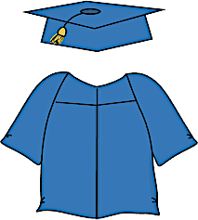
Gatekeeping (Supply-Side)
Notes:
Now we turn to supply-side gatekeeping; that is, gatekeeping that comes from the academic end of the interaction. Our understanding of a given subject is usually formed from multiple scholarly perspectives; in the climate change and conflict literature, it’s the result of interactions between scholars who argue for very strong impacts of climate on conflict, those who argue for moderate or socio-politically and economically context-specific effects, and those whose work finds little if any relationship between the two. And some of these scholars defend these positions more vociferously than others – I’m sure you can think of examples in your own areas of expertise.
Typically, policymakers will not have the time or the desire to convene all the relevant experts and hear them out. There is some process by which the universe of potential experts is winnowed to a tiny fraction of the relevant pool of expertise – and if we’re being honest, that winnowing process often is driven by highly idiosyncratic factors that have little to do with whether the expert is objectively correct or representative of scientific consensus. Issues like academic seniority, perceived status of an academic’s institution, race and ethnicity, gender, can matter quite a bit. And who gets in the room can matter quite a bit.
In this scenario, the consensus (or lack thereof) is the whole picture; again, the Starry Night. Different scholars contribute in different ways, one painting the shining moon, one painting a swirling cloud, another painting a cypress tree. This winnowing process results in one of those scholars being invited to represent “the academic perspective.” The scholar then proceeds to describe their perspective as representative of the academic perspective, rather than conveying the range of perspectives and attempting some kind of synthesis, or even just acknowledging disagreement. This is akin to what George and Jay referred to as deception by omission. And this is all assuming the academic is using their access and expertise to convey their understanding of the subject as a social scientist. Roger Pielke is worried about a different variant of this: using access and expertise to engage in what he calls stealth issue advocacy.

Slide 9
Stealth Advocacy
Stealth issue advocacy (def): when scientists claim to be focusing on science but are really seeking to advance a political/policy agenda (Pielke)
  Academics’ epistemic practices give them a claim to knowledge, expertise policymakers generally lack
“Activists masquerading as academics”
Notes:
The distinction between issue advocacy and stealth issue advocacy is an important one, and boils down to whether the scholar is acknowledging and owning their position as issue advocate or whether they are cloaking that advocacy in a sheen of scientific objectivity.
To Pielke, stealth issue advocacy occurs when scholars press a private political agenda using their academic credentials as cover. Pielke is right: as academic experts, we have differential status and a claim to expertise that is distinct from the claims made by other groups. That claim to expertise is rooted in our in our epistemic practices, but those same epistemic practices can exacerbate the tendency to privilege our own findings over consensus positions, hide weaknesses in our own analysis, and to minimize or mischaracterize the state of disagreement in particular areas.

Slide 10
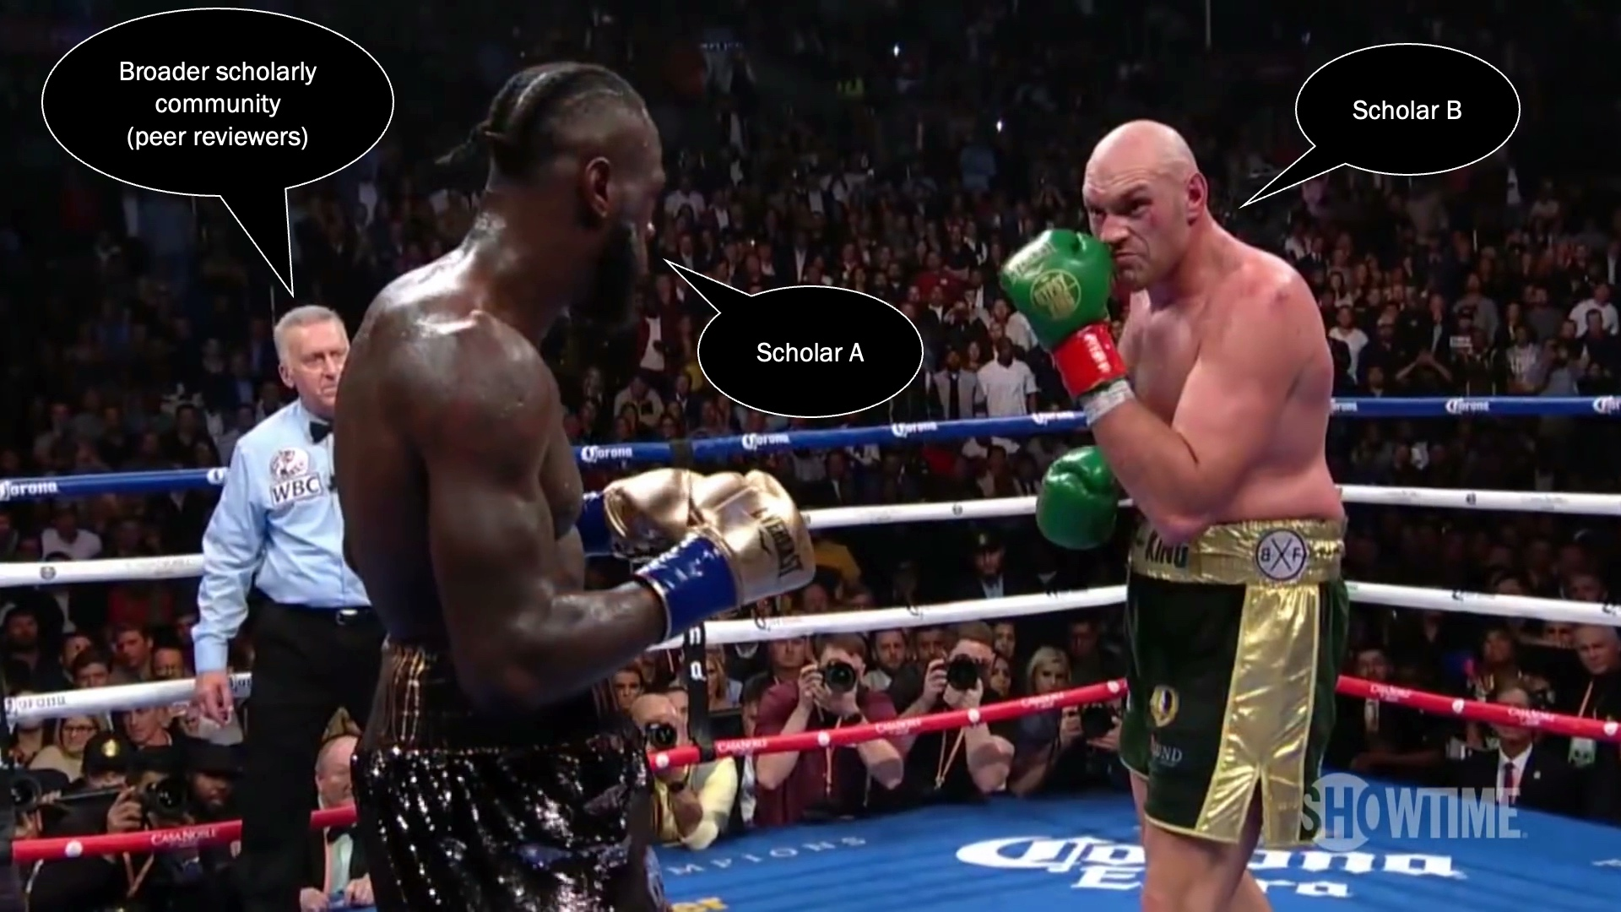
Temptation can arise on normative, but also professional grounds
Academic incentives: win academic “debates”, get disciplinary recognition
Scholars may agree on 98% of facts under discussion, discourse will revolve around 2% of disagreement
Notes:
One of the more dominant forms of scientific discourse is adversarial. Think of this form of discourse as a boxing match, in which the boxers are the scientists or teams of scientists, the referee is the review process, and the judges are the wider scientific community. Only in this boxing match, there are few (if any) true knockouts, or decisive findings that irrevocably put the matter at hand to bed. There are only wins on decision: the collective assessment of the wider scientific community decides who wins and who loses. And there are constant rematches.
For our purposes, the most important implications of this mode of discourse are two. First, it structures discourse according to the adversarial logic of debate: the goal is to win, or have the last word. And since scientists are flawed human beings with personal pride, egos, and reputations at stake, we tend not to take too kindly to losing—we are often the last ones to concede. Second, the adversarial mode of discourse incentivizes the accentuation of disagreement and the taking of clear, unambiguous positions on complex issues. Two scholars or teams of scholars might agree on 98% of the relevant facts and issues under discussion, but their interactions will revolve almost entirely around the 2% over which they disagree, often vehemently. We are rewarded for findings and contributions that stand the test of time, and part of standing that test of time is defending that turf against rebuttals.

Slide 11
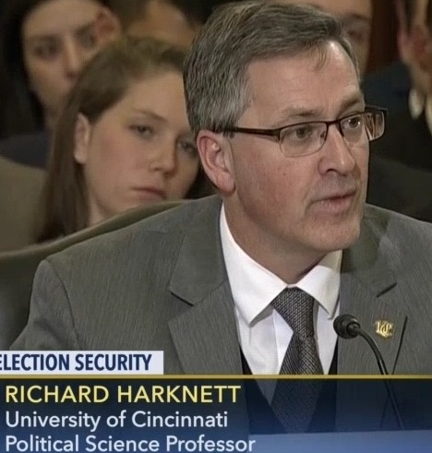
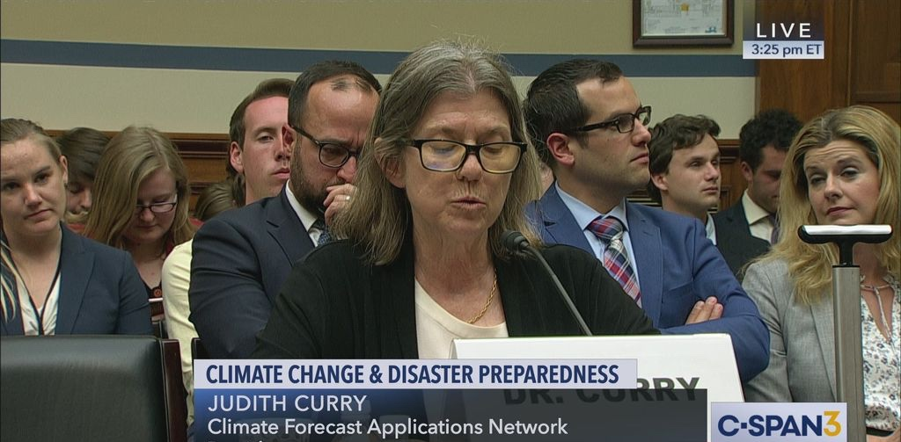
Notes:
This issue is exacerbated by issues like academic seniority and thus perceived expertise. This hasn’t been true of all my interactions with policy constituencies, but often the most seriously considered, or at least loudest and least caveated, voices in the room belong to senior academics. The longer you’re in the profession and the more accolades you receive, the more likely you are to privilege your perspective over consensus. And this probably suits the policymakers at the stage of these kind of public hearings just fine – by the time you are at this point in the process, you are there for confirmation purposes, not for educational purposes, if I understand Judd and Leanne correctly.

Slide 12
Academic Rank | Agree/disagree/neither with “In policy discussions, I value the conclusions of my own research over the scholarly consensus on an issue.”
Chaired Professors | 47.4% / 21.0% / 31.6%
Full Professors | 40.3% / 24.1% / 35.7%
Associate Professors | 32.0% / 37.4% / 30.6%
Assistant Professors | 28.6% / 33.3% / 38.1%
Other | 33.8% / 26.6% / 39.6%
Total | 36.0% / 29.4% / 34.6%
Cullen S. Hendrix, Julia MacDonald, Susan Peterson, Ryan Powers, and Michael J. Tierney. “Beyond IR’s Ivory Tower,” Foreign Policy, September 28, 2020.
Notes:
Our team’s work on international relations scholars’ policy engagement activities, which Julia and Ryan will be discussing later, finds that nearly half of chaired professors value the conclusions of their own research over the scholarly consensus on an issue when discussing these issues with policymakers; only 20% of those chaired professors express deference for scholarly consensus over their own findings when discussing topics with policymakers. Confidence in one’s own work relative to scholarly consensus seems to be a strong function of seniority. And why not? After building successful careers under the adversarial model of scientific discourse, why wouldn’t they stick to their guns?
And here’s the kicker: to the extent academia actually wants to value policy engagement, it will start looking for evidence of individual impact – this is pretty common in the think tank world, at least in my experience, where this kind of influence over specific policy proposals and their adoption is a coin of the realm to a much greater extent than it is in academia. And this will create an incentive structure that further entrenches the desire to show unique impact and the temptation to act as gatekeeper.

Slide 13
Gatekeeping (Demand-Side)
Notes:
This form if information gatekeeping can be exacerbated when policymakers strategically involve themselves in the process of inviting in academic expertise. This point relates to one made earlier by Judd and Leanne; you may not know who invited you into the room and what that says about the type of expertise or perspective they are interested in forwarding. This is the crux of the problem Adam Elkus addresses – quite crudely and using language that may offend – in his piece on the problem of bridging the gap: Joe Policymaker wants a specific outcome, so Joe Policymaker solicits input and leverages the claim to authority of whatever academic concords with their perspective. That is, the policymaker reaches back into the pool of relevant academic expertise and cherry picks the individual who will effectively gatekeep scholarly knowledge in a way that will forward the policymakers’ agenda:
Political scientists have this strange, naive belief that policymakers are just uninterested actors looking for the best advice they can find and if only they could be fed the political science in a form that their unique tribe understands everything would be a-ok. It’s almost as if political scientists — who study the strategic behavior of political actors — throw all of their own research out the window when naively formulating their notions of policy relevance.
Elkus’s point is worth considering, and I’d be eager to hear from some of our policymaker instructors about what they think about that statement. Are strong priors of this type always present? Is there a role for informing discussion, rather than being marshaled as a cudgel to drive home a pre-ordained policy decision?
I have no doubt this happens – indeed, I think it’s happened to me. I’d say that the closer one gets to interacting with someone who stands for election or is often near TV cameras, this becomes more and more likely. The more staged and produced the interaction, the less, at least in my experience, you should assume your discussion is one rooted in a real desire to learn from expertise.

Slide 14
Dealing with Cherry Picking and Gatekeeping
Some (esp. on demand-side) is essentially inevitable
  Can’t manage use, but can manage any potential professional fallout
  Can choose not to re-engage
Most (on supply-side) is up to you and your choices
  Engaged scholar as uniquely wise seer or emissary of epistemic community?
  Do you act as (stealth) issue advocate or honest broker?
  Where do you distinguish between your normative stances and your social scientific knowledge?
  You might be wrong. What then?
Notes:
So, how do we deal with this as academics? I think we must start by acknowledging that some of this, especially on the demand-side, is essentially inevitable. Even scholars who make no attempt to bridge the gap can find their work presented in bad faith; especially in a Google Scholar-informed world, the gist of much of our work is out there for quasi-public consumption. You don’t have to actively engaged to have your work manipulated or taken out of context as evidence for someone’s particular axe to be ground.
When this happens, especially in public fora, you can choose to clarify the record and identify how you’ve been taken out of context. This won’t stop bad-faith actors, but it can help to guard your professional reputation among other social scientists – and that is something worth guarding in and of itself. And you can choose not to re-engage.
But, on the supply side, a lot is really up to you, and the choices you make when engaging in these types of discussions – and by extension, when you write for general audiences. Do you engage as a uniquely wise seer with privileged knowledge and opinions, or do you engage as essentially a privileged representative of an epistemic community, with an obligation to acknowledge your own biases, your positionality vis-à-vis conventional academic wisdom, and attempt to acknowledge areas of disagreement and the reasons for them? Do you act as an issue advocate, stealth issue advocate, or honest broker? How do you think about the relationship between your own normative stances and commitments and your social scientific knowledge, acknowledging that we’re often only dimly aware of our ultimate motivations? And finally, to the extent we consciously or unconsciously engage in gatekeeping, what are the implications if we’re wrong?
I’m not suggesting academics cannot be activists; I am suggesting that it’s preferable that we try to be cognizant of how our normative goals and commitments, as well as our professional incentives, affect the way we use scholarship, and our social status as scholars, to inform and/or persuade. Thanks!

