Slide 1




May 6 – 7, 2021
Sié Chéou-Kang Center for International Security & Diplomacy
Josef Korbel School of International Studies
University of Denver
Sponsored by Carnegie Corporation of New York

Slide 2
Positionality and the Ethics of
Partnered Policy Engagement
Oliver Kaplan
Notes:
The Ethics of Partnering with Civil-Society Organizations for Policy Engagement
This module explores a relatively new and still infrequent form of policy engagement: collaboration between academics, local peacebuilders, and NGOs in the dissemination of research findings and policy implications. This form of policy engagement can be referred to as “partnered engagement.” The lecture component focuses on the example of sharing of the successes and failures of community-based atrocities prevention strategies with other NGOs and government policymakers.
The exercise will move participants to consider questions about researcher positionality and roles, such as either representing the researcher’s own work and findings or interpreting the collaborator’s work. It will also coach participants to develop their own guidelines and practices to ensure ethical and equitable engagement, such as applying Immanuel Kant’s notion of a “categorical imperative,” or valuing something or someone as an end in themselves, and not using them as a means to achieve some other end. In this context, this principle can guard against the local actor being “used.”

Slide 3
Partnered Engagement
What is partnered engagement?
What is positionality?
Modalities of engagement (write, brief, etc.)
Pros, cons, risks
Guidance: Identifying and managing positionality
Notes:
This presentation will cover several key issues, including:
Defining partnered engagement
Reviewing positionality and how it applies to policy engagement
The possible Cost-benefit balance of partnered engagement for the different participants
And the importance of manage positionality and evaluating the experience

Slide 4
Partnered Engagement
Many actors are left out of the policy engagement process
  Views are filtered by researchers
Partnering: Directly includes these voices in the engagement
Collaboration and strategizing among partners
  Not simply giving separate, uncoordinated remarks
Notes:
Defining Partnered engagement
Partnered engagement is an option for including voices that might be normally left out of the process
As we will see, the process involves coordination and complementarity among the participants

Slide 5
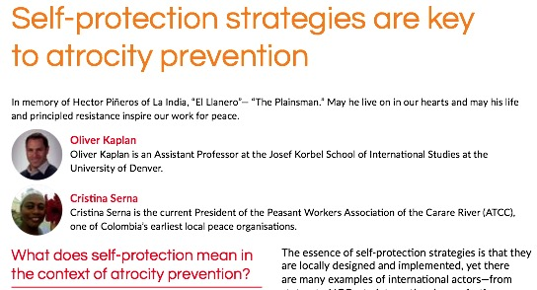


Notes:
Oliver Kaplan began his partnered engagement experience in 2017, when he was contacted by the NGO Peace Direct,
He partnered with Cristina Serna of the Peasant Worker’s Association of the Carare River (ATCC) in Colombia, a local peacebuilder. Cristina had to conciliate threats against residents of her community during the very days of Peace Direct’s online consultation!
Cristina was on the move the days of the consultation and did not have reliable internet connections in the campo (countryside) of her isolated corner of Colombia.
To manage this challenge, as participants posted comments, Oliver would translate them from English to Spanish using Google Translate and send the text to Cristina through a WhatsApp chat (and would then back-translate and post her responses to the online forum).

Slide 6
Positionality
Positionality is the act of recognizing ones’ relative social position and how others may conceive of it
Most literature on fieldwork positionality (nothing on policy engagement?)
  Access and comfort in policy arena
  Interpreter role: understanding the policy interlocutors and influence (not just facts, but actionable procedures/ beliefs, etc.)
  Demographic differences among partners
Notes:
Partnered engagement acquires its persuasive power precisely from the different positions held by the different participants.
The concept of Positionality is used to help identify these differences and apply them in the engagement process.
It originates with FEMINIST GEOGRAPHERS: “Accounting for ones’ positionality is the act of recognizing ones’ relative social position and how others may conceive of it“
(England 1994, Bourke 2014)
Cristina is an Afro-Colombian woman from a small rural community with leadership skills but had language limitations and was on her first international trip. By contrast, Kaplan is a White man and was in a familiar country, city, setting, and language in Washington DC where the engagement took place. He also had the benefit of the (modest) prestige of being a Ph.D. researcher (to help get in the door) plus some base level of legitimacy from past field experience. In this sense, he was more of an “insider” in this context, while she was more of an “outsider” (Chavez 2008, Merriam 2010).
It is good practice to assess these questions beforehand.
However, one thing to keep in mind is that these Positionalities may only be most visible once an engagement opportunity has commenced in person,

Slide 7







Positionality and Engagement
+
Notes:
Positionality in engagement means that different types of researchers and local actors—academics, advocates, peacebuilders, etc.—may have different types of experiences and relationships with policymakers when they engage with them.
Indeed, even the stock clip art shows there are stereo types about certain individuals
Global north academics (older white males?) may engage with global north policy actors (also older white males?)
But others may engage with other kinds of policy actors
There may be different balances of power, acceptance, respect, etc. in these relationships

Slide 8



Our Host Organizations
Notes:
The Stanely Center and Peace Direct Created the opportunity for partnered engagement—by providing resources, and convening couldn’t have been done without them
Kaplan’s article includes THEIR VIEWS, CRISTINA’S, his own
These organizations had their own interests that had to be taken into account in the engagement, such as possibly seeking: Credit, reputation, Influence, Money, Status, Position
They ideally want to show their programs and engagement efforts have impact and build relationships; and did they spent the money of their USIP sponsors well? Stanley is based in Iowa and so was also trying to maintain ties in big cities (?)
Just like ICRC had policy interests but less strong interests in academic research

Slide 9
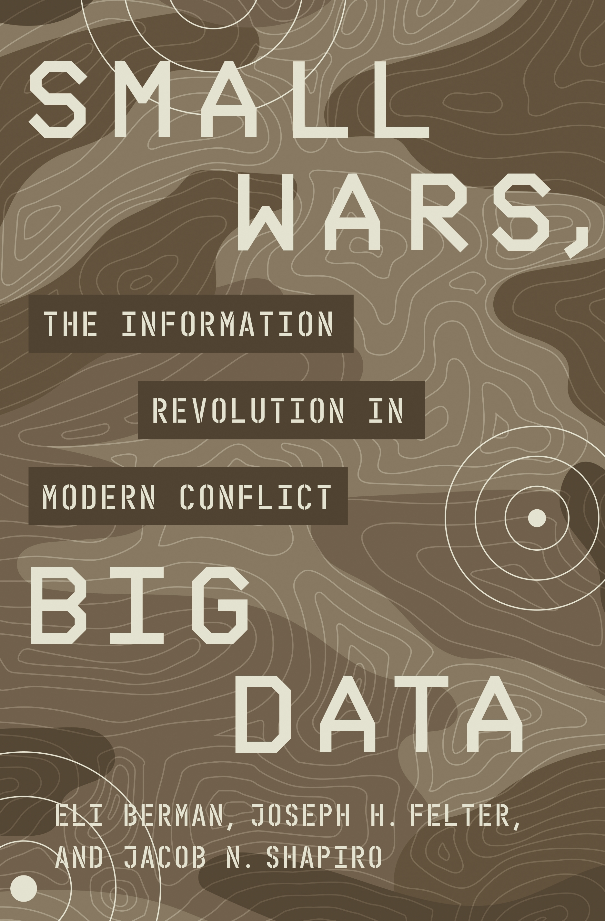
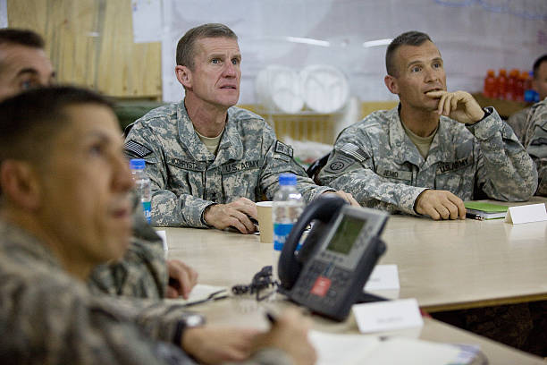
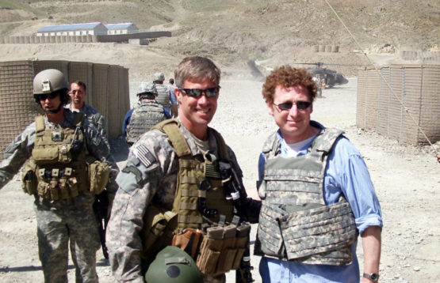
Partnering with Bureaucrats & Military?
Notes:
* Retweet is not an endorsement here, but there are some other possible examples of partnered engagement on related topics:
One example is the possibility of partnering with a Gatekeeper/ Ally in the policy process.
This involves conducting joint presentations of research findings by academics and bureaucrats (or academics and activists) to higher- level policymakers. Berman et al. (2018) report instances of academics partnering with subordinate military officials to brief research findings to higher-ranking commanders.
https://media.gettyimages.com/photos/commander-general-stanley-a-mcchrystal-points-to-a-diagram-on-the-as-picture-id91547491?k=6&m=91547491&s=612x612&w=0&h=lD5kPjMnmTQ895EfUIvTbJWRlYAAWRQtWDuSShme3Vw=
https://www.gettyimages.com/detail/news-photo/commander-general-stanley-a-mcchrystal-meets-with-high-news-photo/91550423
https://news.stanford.edu/2020/11/10/special-forces-veteran-stanford-scholar-applies-data-scholarship-conflict/
Special forces veteran and Stanford scholar Joseph Felter will never forget when U.S. Army General Stanley McChrystal was briefed on a study Felter had co-authored concluding that civilian casualties inflicted by international forces in Afghanistan increased insurgent violence.
McChrystal was gripped by one finding in particular in the analysis by Felter and his colleague, Radha Iyengar: If the International Security Assistance Force (ISAF) could eliminate incidents that left at least two civilians dead, then there would be one less insurgent attack over the following six weeks.
“General McChrystal started tapping his microphone and said to his field commanders joining the video conference call from across Afghanistan, ‘Everyone, look, this is what I’ve been preaching since I’ve been here: We have to protect the population,’” recalled Felter.
At the time, Felter was deployed to Afghanistan as the first commander of the ISAF Counterinsurgency Advisory and Assistance Team. He recruited Iyengar, along with other scholars, to help the team better understand problems they faced on the ground.

Slide 10
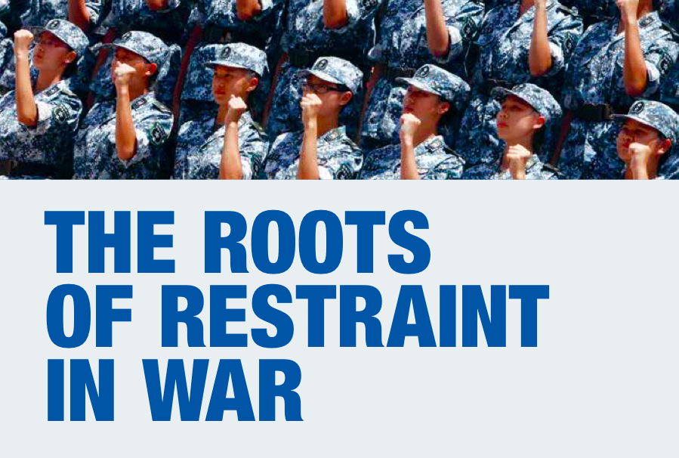
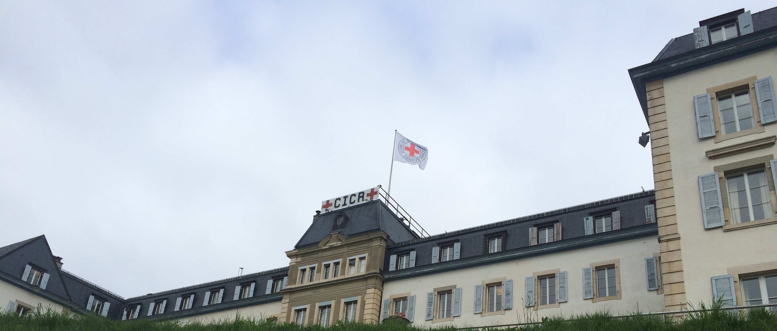

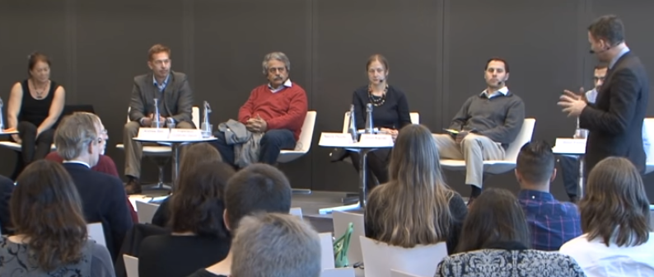
ICRC and Humanitarians?
Notes:
https://www.youtube.com/watch?v=FgTMp8EaZHI
In the case of the Roots of Restraint project supported by the International Committee of the Red Cross (ICRC), Academics partnered with iCRC staff to develop findings for rest of organization, leadership, and humanitarian sector.
In the picture of the panel session we see an ICRC staffer who tees up a question to a scholar to brief the audience of ICRC practitioners (Literally being corralled or bookended by ICRC staffers on stage)
→ This project involved flying around the world; literally going into war zones
→ The briefing mainly showed positive mechanisms of inducing restraint among armed actors; perhaps less a focus on academic findings or negative findings

Slide 11
Do you know of any examples of
“Partnered Engagement”?
Notes:
To discuss with the audience or class:
Do you know of any examples of “Partnered Engagement”?

Slide 12

Benefits: Academic and Partner
More direct communication
Local partner’s presence: “costly” engagement
Partner has greater control over their findings
Build international networks/ cultural exchange
Remuneration $
External validity of findings/ share academic findings (academic)
Notes:
Partnered engagement can be thought of as a more direct from of communication—less of a game of “telephone” where insights may be lost in translation via the academic researcher.
The approach could provide more accurate and impactful information to policymakers
The partners or local actors may not know all the policy recommendations their work has for other actors or cases
Kaplan shared his findings plus broader academic findings
The local partner’s presence is a costly form of engagement that may attract greater policymaker attention, and the partner can convey more stories, specific examples, and nuances based on their experiences.
With the partner present, there is greater control over how their views and findings generated from their lived circumstances are communicated to policy audiences.
The process also helped to build their international networks, and benefit from an opportunity for travel and cultural exchange.
Serna received a small amount of remuneration for her efforts

Slide 13
Costs to Partners
Logistical/ travel issues
Hardships: Time away from actually building peace
Risks from engaging governments (?)
Rifts and jealousies within communities
Who’s in the room:
Elevated some countries, communities, and individuals over others (“globalized locals”; English-speakers?)
Notes:
However, there are also some potential costs that may be imposed on partners in the engagement.
The process can elevate some countries, communities, and individuals over others in benefitting from the engagement opportunity.
The participation and travel also posed opportunity costs and potential hardship on the local peacebuilder. Logistical issues were a challenge in this case. The peacebuilder required a visa and passport.
Organizing the participation and travel also posed opportunity costs and potential hardship on the local peacebuilder by reducing the available time for her daily peacebuilding work and economic activities—took her time away from actually building peace.
There is also the potential to cause rifts and jealousies within communities. Participation can confer benefits such as travel, access, prestige, etc.
There could be risks to partners in some cases by engaging with national or foreign governments, whether directly or when others convey their experiences.
To be successful, partnered engagements should account for these potential burdens and researcher positionality.
There are also some possible limitations to only English-speakers—it can limit the views available to primarily those from the “globalized” locals.

Slide 14





Logistics!
Notes:
The various logistics for traveling from rural Colombia to Washington, DC were challenging for Serna!
They also took time for Kaplan to assist with!

Slide 15
Flipping Engagement
Notes:
As part of the positionality and partnered engagement, Kaplan began building his relationship with the community actors by first “flipping the engagement”
He did this by first presenting his research back to the ATCC community with which he conducted his research. This gave them reassurance that they would know they kind of content he might later share to policymakers in the context of a partnered engagement. It also helped show them the kinds of presentation approaches that might be more common or easily understood in the global north.

Slide 16
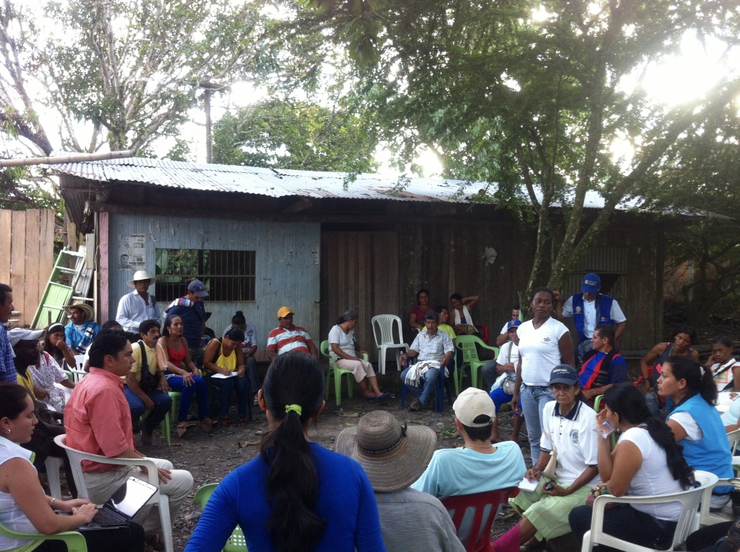
Notes:
Cristina Serna In her element, leading a community meeting with the ATCC in 2013 (photo by Kaplan)

Slide 17
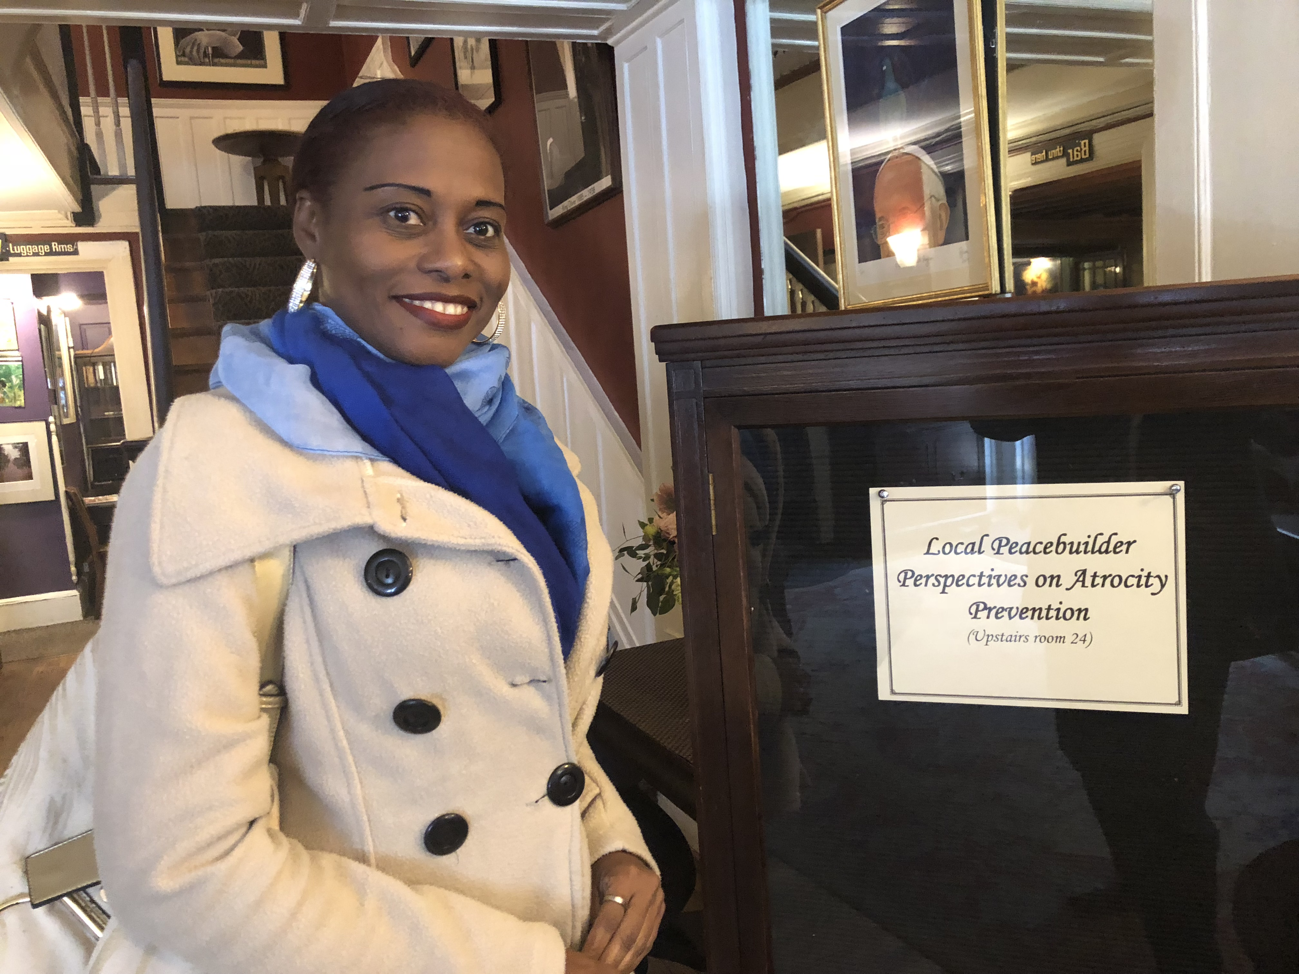
Notes:
At dinner meeting in Washington, D.C. (photo by Kaplan), co-presenting of findings and experiences at in-person briefings in the U.S. with NGOs and policymakers.

Slide 18
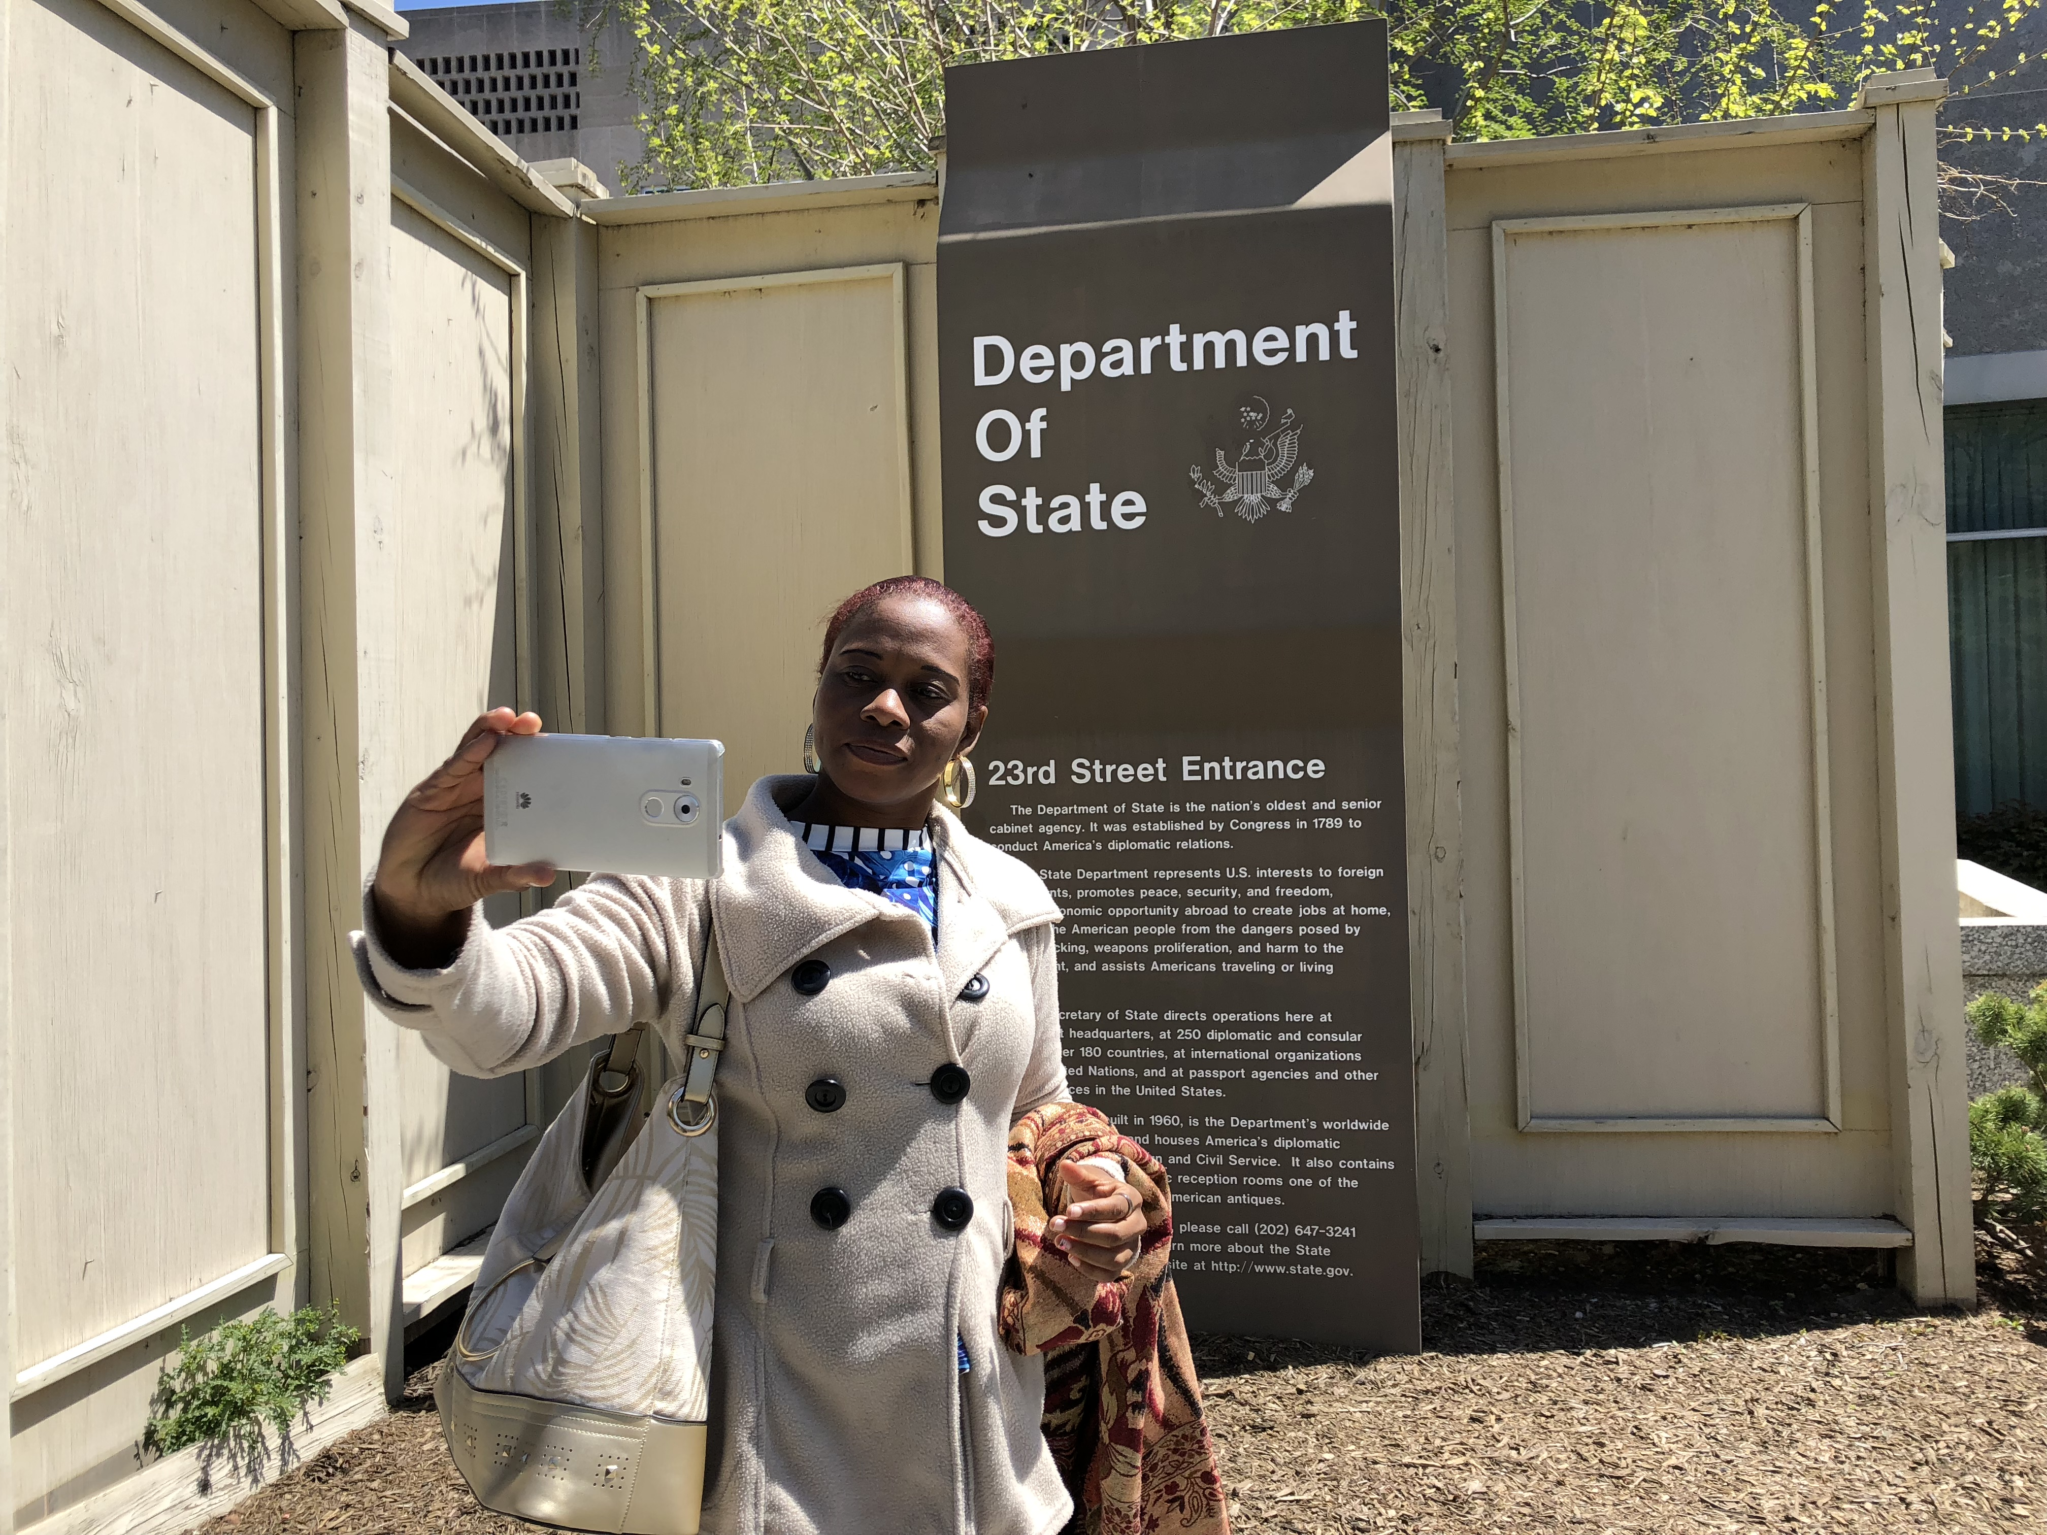
Notes:
Serna at the U.S. State Department (photo by Kaplan)

Slide 19
But Ethical Pros/Risks of positionalities
Guidance from…
Immanuel Kant’s
Categorical Imperative
Notes:
Even with there advantages of partnered engagement, there may be risks. How handle this?

Slide 20
The Categorical Imperative
Treat others as an end in themselves, not a means to an end
But… the principle of “operational reason”:
Allows deriving other benefit, so long as operational (primary) reason adheres to the imperative
So...
Can derive benefit from partnering, so long as main reason (and interest) for acting is that of the partner
Notes:
The Categorical Imperative is a helpful guide, thought its application could vary depending on the type of partner, balance of the relationship
It calls for us to Treat others as an end in themselves, not a means to an end
The primary aim of engagement should be for attaining some greater good, such as helping the local actor communicate their knowledge or needs, and helping policymakers to craft pareto-improving policies. It should not be undertaken for virtue-signaling, gaining credit or recognition, or (strictly) promoting ones’ own aims or distinct research findings.
These very worries help keep researchers “honest” in their conduct vis-à-vis other actors. A kind of precautionary principle
Costs to the researcher to participate in terms of time, effort; and may not get clear benefits, unless operational reason holds
As such, it would only mainly make sense to participate in the engagement from a moral, altruistic perspective and not from some other cost-benefit calculation.

Slide 21

The Imperative of Evaluation
Given costs or risks, engagements should be evaluated if possible
Cristina and others traveled 24 hours…
  Most policymakers didn’t bother
  to complete short surveys
Assessing “informing” vs. decisions?
Notes:
Academics don’t often get the call back from policymakers about how their research was used/ how impactful
POLICYMAKERs should shift their VIEWS OF WHAT IS REQUIRED FOR ENGAGEMENT in terms of feedback, since…
If there are potential costs from partnered engagement that fall on the more vulnerable partner, then it is important to verify that it is worth the effort. Crisitna’s life was disrupted someone’s life (when she could have been mediating to save lives!). In other words, it is important at the engagement not simply be performative, going through the motions—then it could violate categorical imperative or just be window-dressing
The impact might be greatest on policymakers at the “Beginning of the policy chain”: The greatest marginal impact with policy participants who are interested in learning from local actors but have not previously enjoyed many such opportunities
In Peace Direct’s evaluation, a modest 17 total respondents completed the survey--Policymakers often juggle busy schedules--but so do civil society actors.
An anonymous participant suggested that the “biggest challenge in engaging with local communities are the [politician or community] gatekeepers who... often give biased information.” This can harm the credibility and legitimacy of local peacebuilders trying to engage with policymakers. This speaks to the utility of direct or partnered engagement,

Slide 22
Conclusion
Collaborator relationships don’t have to end:
A duty to not just “extract”
Risks that can be managed
Evaluate: Encourage policymaker feedback
When partnered vs. normal engagement?
Online forums in the post-COVID reality
Notes:
Members of the ATCC report not having received any follow-up or sustained partnership from the policymakers or organizations that Cristina met with during her stay in Washington, D.C

Slide 23
Co-Engagement, Co-Briefing
As a group, select an individual who is a research or policy collaborator or subject (e.g., activist, bureaucrat, military, NGO/humanitarian) from your project, or one you know
Imagine a scenario where you team-up to share the results
Reflect on the following issues:
  What are your interests? What are the collaborator’s interests?
  What is your positionality relative to theirs?
  Who is your policy interlocutor? What is their position/ interests? How might you/partner be viewed or received by your policy audience?
  What are the possible pros/ cons/ risks of the engagement (overall, and for each involved)? What is the best case outcome?
  What roles might you each take in the engagement/ what will you each share?
  Consider applying the Categorical Imperative:
  how might you change your approach to engagement?
  How might you evaluate the impact of your engagement?
Notes:
Credit, reputation,
Influence
Money
Status
Position

