Slide 1

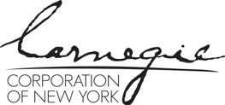


May 6 – 7, 2021
Sié Chéou-Kang Center for International Security & Diplomacy
Josef Korbel School of International Studies
University of Denver
Sponsored by Carnegie Corporation of New York
Notes:
One hour session: Approximately 25 minute intro and slide presentation; 15 minute breakout groups; 20 minutes reporting back and plenary discussion.

Slide 2
Unintended Consequences:
How Good Faith Policy Advising and Interventions
Can Lead to Bad Outcomes
Naazneen Barma & Rachel Epstein
Notes:
The overarching goal for this session is to put on the table some of the unintended consequences that can emerge when scholars engage in policy advising and other policy-related work, so that scholars can be aware of such challenges (and the potential, even, for negative outcomes) when choosing when and how to engage in the policy process. We also cover seven suggested strategies and practices to avoid being blindsided by such potential adverse consequences and to begin to mitigate them in advance. Some of those suggestions are just a reiteration of best practices that most scholars receive as part of their routine PhD training. But others speak to a possible, needed cultural shift in which academics be much more forthcoming about their baises and political commitments where they exist, and to periodically re-evaluate their work to identify earlier errors in reasoning, judgement or data.
It’s important to recognize at the outset that when and how these challenges might materialize and our proffered strategies might work to counter them will vary depending where in the policy cycle a scholar chooses to or is able to engage.

Slide 3
What’s the Problem?
Problematic practices in which researchers might engage that can be exacerbated by policy engagement:
Policies can misfire—and sometimes researchers have enabled poor policies
Overstatement of research findings
Inferring too much about the future from existing outcomes
Failing to take into account possible future scenarios or alternative explanations
Adopting undue stridency or certainty in order to gain policy traction
Portraying problems in overly simplistic ways
Inexplicit bias infuses analysis
Notes:
Researchers who are engaging in (or interested in engaging in) the policy process can — sometimes, and under certain circumstances — find themselves doing so in ways that are problematic for both scholarship and policy practice. Scholars may inadvertently enable poorly-performing policies. And, because we cannot always anticipate how policies will be implemented or what their full ramifications might be, some policies might cause severe harm.
Take the example of the international peacebuilding and statebuilding scholarship in the late 1990s and early 2000s, a great deal of which was motivated by what Roland Paris called “the cult of the relevant,” or the desire to be explicitly and immediately relevant to the international interventions that reached their high-watermark around this time. As critical theorists have long observed, some scholarship on peacebuilding was captive to the international intervention agenda. The positivist and probabilistic approach to studying the impact of different dimensions of peacebuilding interventions took as a given the “treatment” that was being applied through international interventions. Instead of interrogating the merits of the standard contemporaneous statebuilding + democratization approach adopted in post-conflict countries in real time and real contexts, the mainstream scholarly approach to peacebuilding was to examine via large-N probabilistic studies what could make the interventions more successful.
Researchers thus:
-- Contributed to the continued application of poor policies, even as they often misfired in practice;
-- Overstated the practical value, scientificity, and certainty of probabilistic findings without taking a more nuanced approach to contingent generalization (Alex George);
-- Fell short of appreciating that the path-dependent dynamics set in motion by international interventions would make the future quite different in terms of outcomes from the near present and often didn’t consider alternative scenarios from the desired end-state; and,
-- In part as a result of a shared commitment to liberal values and a desire for liberal outcomes, portrayed international peacebuilding as a technocratic project, admittedly complex but one to which there was a solution, instead of appreciating it as an inherently political enterprise that was subject to manipulation and subversion.

Slide 4
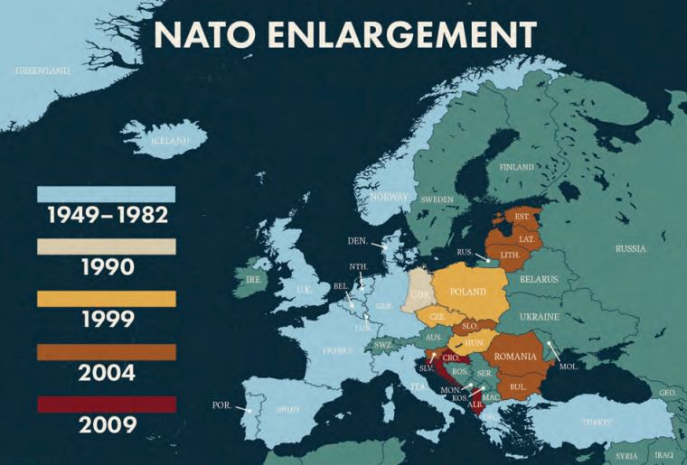
NATO Enlargement to Postcommunist Europe
The Alliance Was Limited in its Democratizing Power
Russian Future Conduct Was Essentially Unknowable
Policymakers Gravitated Toward Findings that were Historically Contingent
Notes:
The case of NATO enlargement to post-communist East Central Europe beginning in 1999 is another instance in which some scholars (and policy-makers) over-generalized their findings, made arguments based on future and unknowable events, concealed important political commitments without acknowledging them, and inferred too much from historical developments that ultimately did not apply to the Alliance’s evolution.
Drawing on Epstein’s 2021 article reviewing the early and more recent literature on NATO enlargement and where researchers and policy-makers over-generalized their findings and thus enabled policies that ultimately did not elicit their intended effect, this discussion covered three specific themes:
From the perspective of 2020, it was clear that NATO had not continued the democratizing path on which it appeared to be committed in the 1990s. A number of scholars assumed that the democratizing trajectory, mostly concerning the democratization of civil-military relations, would continue into the future. A worsening, local geo-strategic environment in addition to protracted wars in Iraq and Afghanistan upended earlier policy trajectories in ways that were perhaps foreseeable, or at least plausible alternative scenarios. These developments downgraded democracy’s importance for the Alliance. Out-of-area wars might have contributed to illiberal socialization for some Alliance members, a point that emerged from Porch’s book chapter.
Critics of NATO enlargement also overstated what they could know about the direct effects of the enlargement policy on Russian conduct. Both sides of the debate also failed to fully acknowledge some critical underlying values—including whether they were privileging big-power relations (principally US-Russian relations) or the perceived democratic rights on East Central European countries.
The lack of significant democratic backsliding in some earlier accessors to NATO provided ostensible evidence that membership in NATO was a cure-all of democratic ills for policy-makers. Pointing to relative historical success in this regard was in part how policy-makers justified enlargement to publics. Although there is now evidence that NATO undermines regional rivalries within Europe (among members), such evidence was rather limited and under-explored at the time those claims were made.

Slide 5

Seven Suggested Remedies:
Academic Best Practice
Identify the Limits of Any Study
Investigate Alternative Explanations
Consider Alternative, Possible, Upending Scenarios
Notes:
The first two of these three suggestions are normally embedded in research training at the advanced level. Nevertheless, they are worth emphasizing. While certainty and stridency might be more likely to gain policy traction, we know that it is important to carefully delimit a study’s findings—in terms of the relevant variables at play, the time-frame in which findings obtain, and limits to external validity that should lead us to be cautious about where else our findings might apply.
Developing and investigating alternative explanations is another way of bringing a sharper, critical perspective to one’s work. In the early NATO enlargement literature, alternative explanations were often theoretically drawn—particularly between constructivist socialization versus materialist incentives. While this debate is relevant to policy making, a wider array of alternatives could have been explored—including whether multiple kinds of socialization within the Alliance were possible or likely.
Considering alternate, possible upending future scenarios might also alert a researcher to the conditions under which trends up to a certain point will likely continue—or not. Few academic programs and disciplines encourage this explicitly, even if in practice some researchers do it to alert their clients of the dangers of inferring too much from what we think we already know.

Slide 6
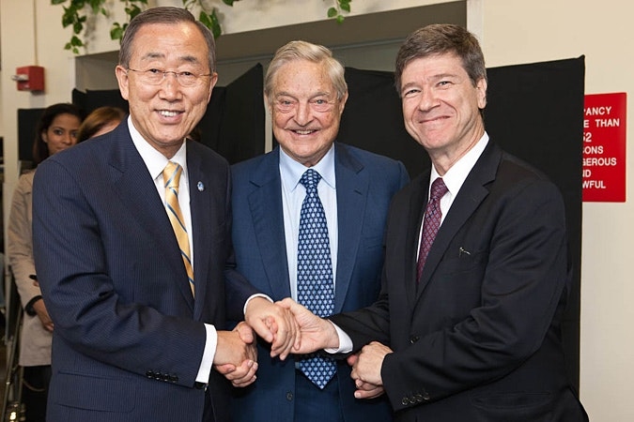
Seven Suggested Remedies:
The Two-Way Street
Refrain from Overstating Findings (provide thorough contextualization for policymakers)
Counsel Policymakers to Embrace, Understand, and Explain Complexity
Notes:
Depicted here are Jeffrey Sachs (the architect of the Millennium Villages Project), George Soros (the chief funder of the project), and Ban Ki-Moon (the UN Secretary-General with whose support the project was associated with the United Nations).
Jeffrey Sachs serves as the poster child for extreme scholarly hubris and the folly of grand, engineered schemes – from his involvement in the neoliberal shock therapy approaches to post-communist transition in Eastern Europe and Russia in the 1990s to his proselytization of the “poverty trap” diagnosis and the massive, comprehensive foreign aid approach represented in the Millennium Villages Project. The approach was premised on a belief in technocratic promise and substantive expertise, the notion that designing the ”right” interventions is a technical problem to which the solution can be engineered.
If, instead, Sachs or his partners had attempted to refrain from overstating their theoretical assertions and associated empirical findings, if they had instead emphasized contextual and contingent understanding and findings, the approach in practice would have looked very different indeed – and would have stood much more change of incremental, experimental, adaptive success.

Slide 7
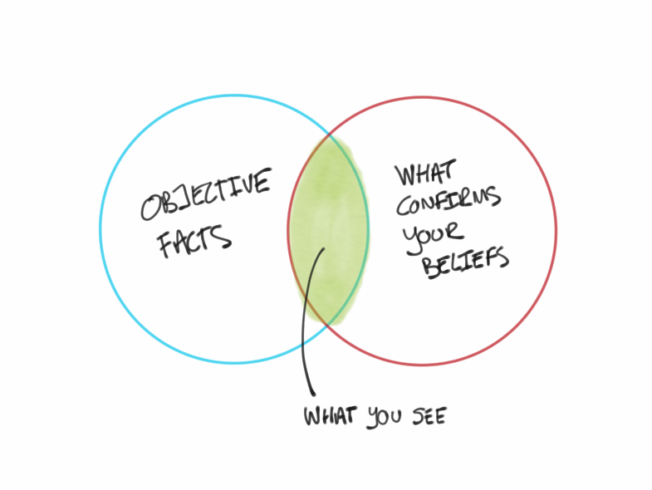
Seven Suggested Remedies:
The Culture Shift
Explicitly Acknowledge Underlying Biases and Political Preferences
Periodically Review and Critically Evaluate One’s Own Work
Notes:
Our sixth suggestion, to explicitly acknowledge political commitments, flies in the face of some advanced training. While many (though not all) social science fields strive for objectivity, we question whether this is realistic or even valuable. Certainly we do not encourage researchers to “prove” a political preference. But we do argue that in the course of our research, we are very likely, not only to reach empirical conclusions, but also value-laden ones. If this is the case, naming them explicitly could improve the quality of discourse around policy. Dr. Valerie Bunce foresaw the Cold War’s end in her 1985 article, The Empire Strikes Back. Having become expert in the languages, histories and grievances of East Central Europeans, she was much better positioned than her Sovietologist counterparts of the same era to perceive the waning legitimacy of Soviet hegemony.
Concerning the seventh suggestion, this module includes some better and worse examples of critical reexaminations of people’s own prior policy engagement—particularly with respect to the US-led War in Iraq in which there were many destructive unintended consequences. The editors at the New Republic make some perhaps questionable judgements about their own earlier arguments. Jonathan Chait’s mea culpa is more forthright. The NATO article also encourages academics to go back periodically and review their earlier work to sensitize themselves against the problem of over-generalization and undue inference.

Slide 8
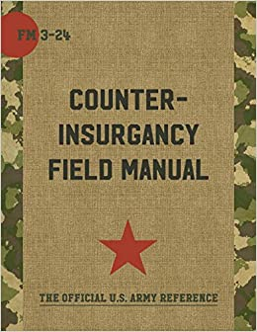
The Risks of Mythmaking for Policy Engagement
Myth-making to Justify Particular Policies
Counterinsurgency as Antithetical to the Democratic Systems that Special Forces Seek to Defend
Notes:
Douglas Porch’s 2013 study on counterinsurgency emphasizes the extent to which some actors engage in mythmaking in order to justify particular policies. Porch traces COIN’s lineage from imperial and colonial wars and demonstrates the gap between purportedly winning hearts and minds and the reality of brute force and coercion against civilian populations.
He concludes that “COIN operations force democracies to compromise the very freedoms and values that they are meant to export abroad” because efforts are made “to liberate COIN from legal restraints of due process and Western political culture” (p. 317.)
Linking his study to the article on NATO enlargement, Porch’s findings alerts us to the idea that socialization and learning within NATO under such conditions would therefore be far from democratic, rule-bound or cooperative.

Slide 9
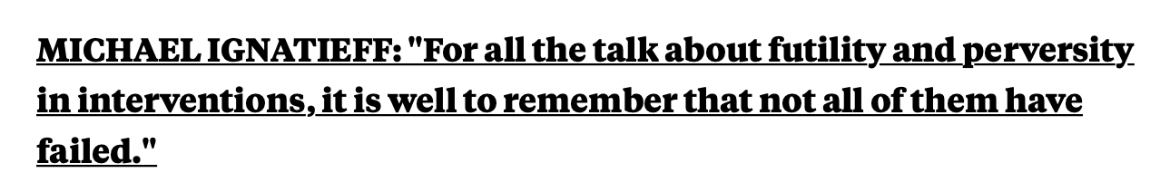
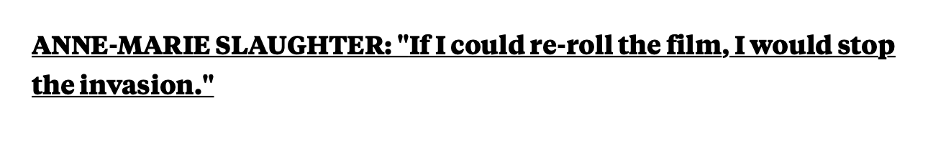
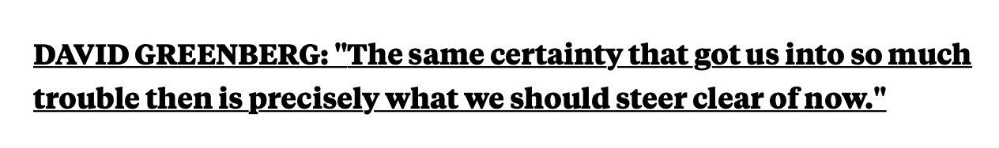
More Mythmaking: The Invasion of Iraq, 2003
The US will:
  “rid the world of an evil dictator”
  “be greeted with candy and flowers”
  “bring a wave of democratic change to the Middle East”
  “drain the swamp of support for jihadist terrorism”
  demonstrate a new paradigm for the efficient use of military force
  jump-start the Palestinian–Israeli peace process (“the road to Jerusalem runs through Baghdad”)
  … and pay for it all through Iraqi oil revenue
Notes:
The assigned Iraq War readings chart a couple of different paths from recognizing what mythmaking looked like at the time that policymakers and scholars advocated for the war to more sober reflections and reassessments some years later.
On the left-hand side of the slide are statements or assertions made by senior George W. Bush Administration officials – all of which could be supported, to some extent or another, by bodies of international relations and comparative politics scholarship: democratization scholarship, theories of diffusion, counter-terrorism studies, military strategic studies, democratic peace theory, studies of oil and conflict, and so on.
We can ask ourselves two questions now:
Should we have known that so many of the key assumptions and assertions underlying the U.S. strategic rationale for the Iraq War would prove false?
How could we have known?
On the right-hand side of the slide, as represented in the pieces assigned as well, are relative degrees of regret and retrospection from engaged scholars who came to recognize that we should have known better.
Wouldn’t we have done better if, as we suggest, policy-engaged scholars had employed alternative scenarios and emphasized (as many, to be fair, actually did) the importance of understanding context and contingency? How could scholars have better communicated uncertainty and complexity to policymakers and, in turn, aided policymakers in communicating that uncertainty and complexity to the public?
As Jonathan Chait points out, we tend to think soberly about immediate costs and benefits, including the moral as well as material dimensions, but we have a much harder time looking into the future and spinning out potential consequences. This highlights how essential it is for scholars to engage in retrospective self-reflection and, ideally, cumulative and collective learning as we engage in the policy process.

Slide 10
Questions for Small Group Discussion
Consider the two cases we’ve presented — NATO enlargement to Postcommunist Europe and the Forever War in Iraq:
How could better training have helped scholars of these two cases explore alternative future scenarios, predicated on past events and research, for the purposes of more responsible policy engagement?
What, in these two cases and the ways in which scholars attempted policy engagement, contributed the most, in your view, to unintended consequences?
What should scholars (and journalists) have done differently to improve the quality of their analysis with respect to these two issue-areas?
How could researchers have helped policy-makers present the complexity of policies and their possible unintended consequences to broader audiences, including to publics?
Notes:
Four breakout groups, each to focus on one (assigned) question from the slide, considering either NATO enlargement or the Iraq War. 15 minutes within breakout groups, followed by 20 minutes (5 minutes max for each group) of reporting back to plenary. Plenary to conclude with a final question for discussion around what other suggestions people have for not enabling flawed policies and preventing unintended consequences via policy engagement.

